Slide 1
RNA-seq with R and Bioconductor

Slide 2
Today’s Instructor
Brendan Jeffrey, Ph.D. Molecular and Cellular Biology
Bioinformatics and Computational Biosciences Branch (BCBB), NIAID
National Institutes of Health, Bethesda, MD USA
NIH - Rocky Mountain Labs, Hamilton, MT USA
Contact our team via email:
Listserv: ACE-GLOBAL-ANNOUNCE@list.nih.gov
Instructor: brendan.jeffrey@nih.gov

Slide 3
What is RNA-seq
RNA sequencing uses next-generation sequencing to reveal presence and quantity of RNA in a biological sample at a given moment in time
Previously used microarrays
Needed to know genome a priori
Poor quantification of low and high expressed genes

Slide 4
Why sequence RNA?
Functional studies
Drug vs Treated
Wild type vs Knockout
Typical RNA-seq differential study
SNP finding – sequence transcripts
Transcriptome assembly
Novel gene finding
Aid novel genome assembly
Splice variant analysis

Slide 5
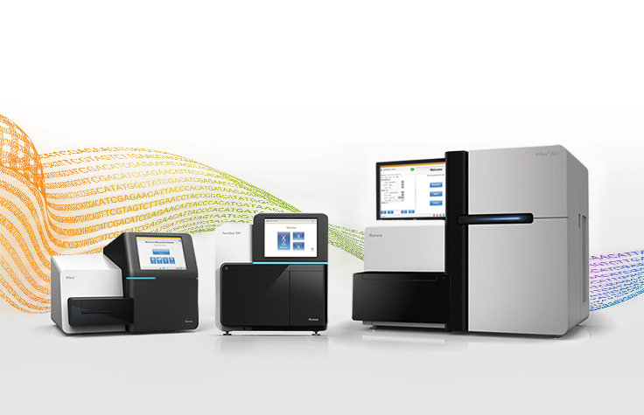
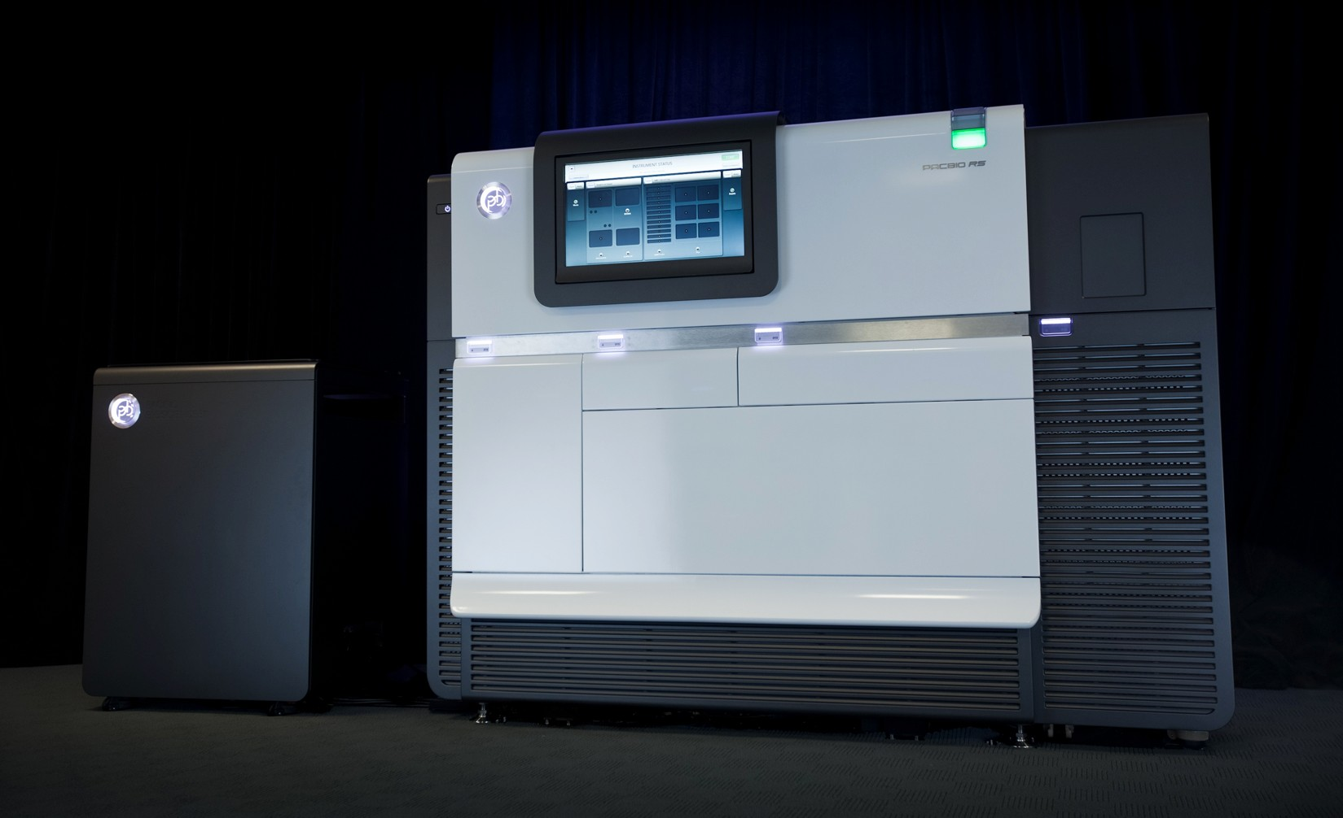
Current Sequencing Technologies
Illumina
Sequence by synthesis
SE and PE reads
1 x 50
2 x 300
Pac Bio, Ion Torrent
Single molecule sequencing
30k to 40k lengths

Slide 6
Current Sequencing Technologies

Slide 7
Current Sequencing Technologies

Slide 8
Why sequence RNA
Functional studies
Drug vs Treated
Wild type vs Knockout
Typical RNA-seq differential study
SNP finding – sequence transcripts
Transcriptome assembly
Novel gene finding
Aid novel genome assembly
Splice variant analysis

Slide 9
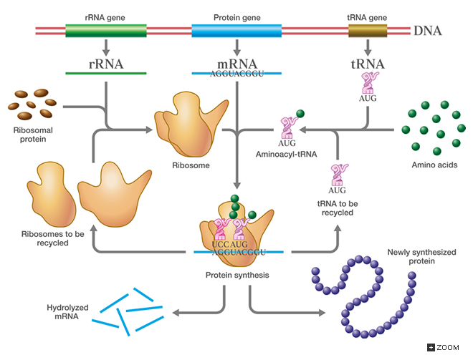
RNA-seq Introduction
Many types of RNA
rRNA, tRNA, miRNA, ncRNA
~2% is mRNA (Eukaryote)
http://csls-text3.c.u-tokyo.ac.jp/active/08_02.html

Slide 10
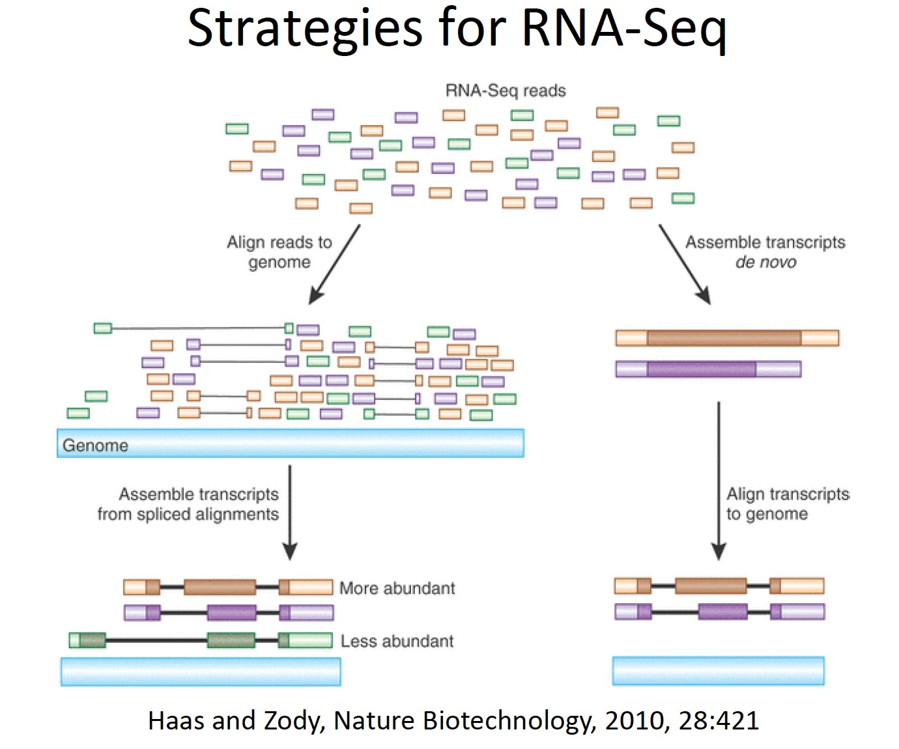
RNA-seq Introduction
Reference Genome?
De novo assemble transcripts
Eukaryote vs Prokaryote

Slide 11
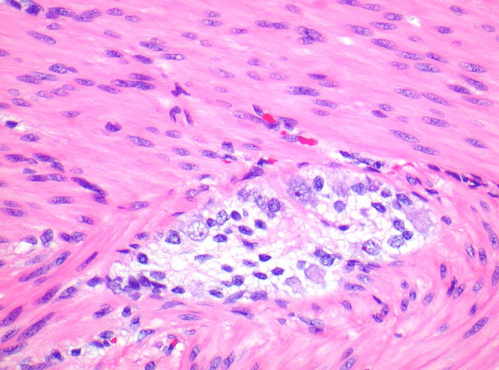
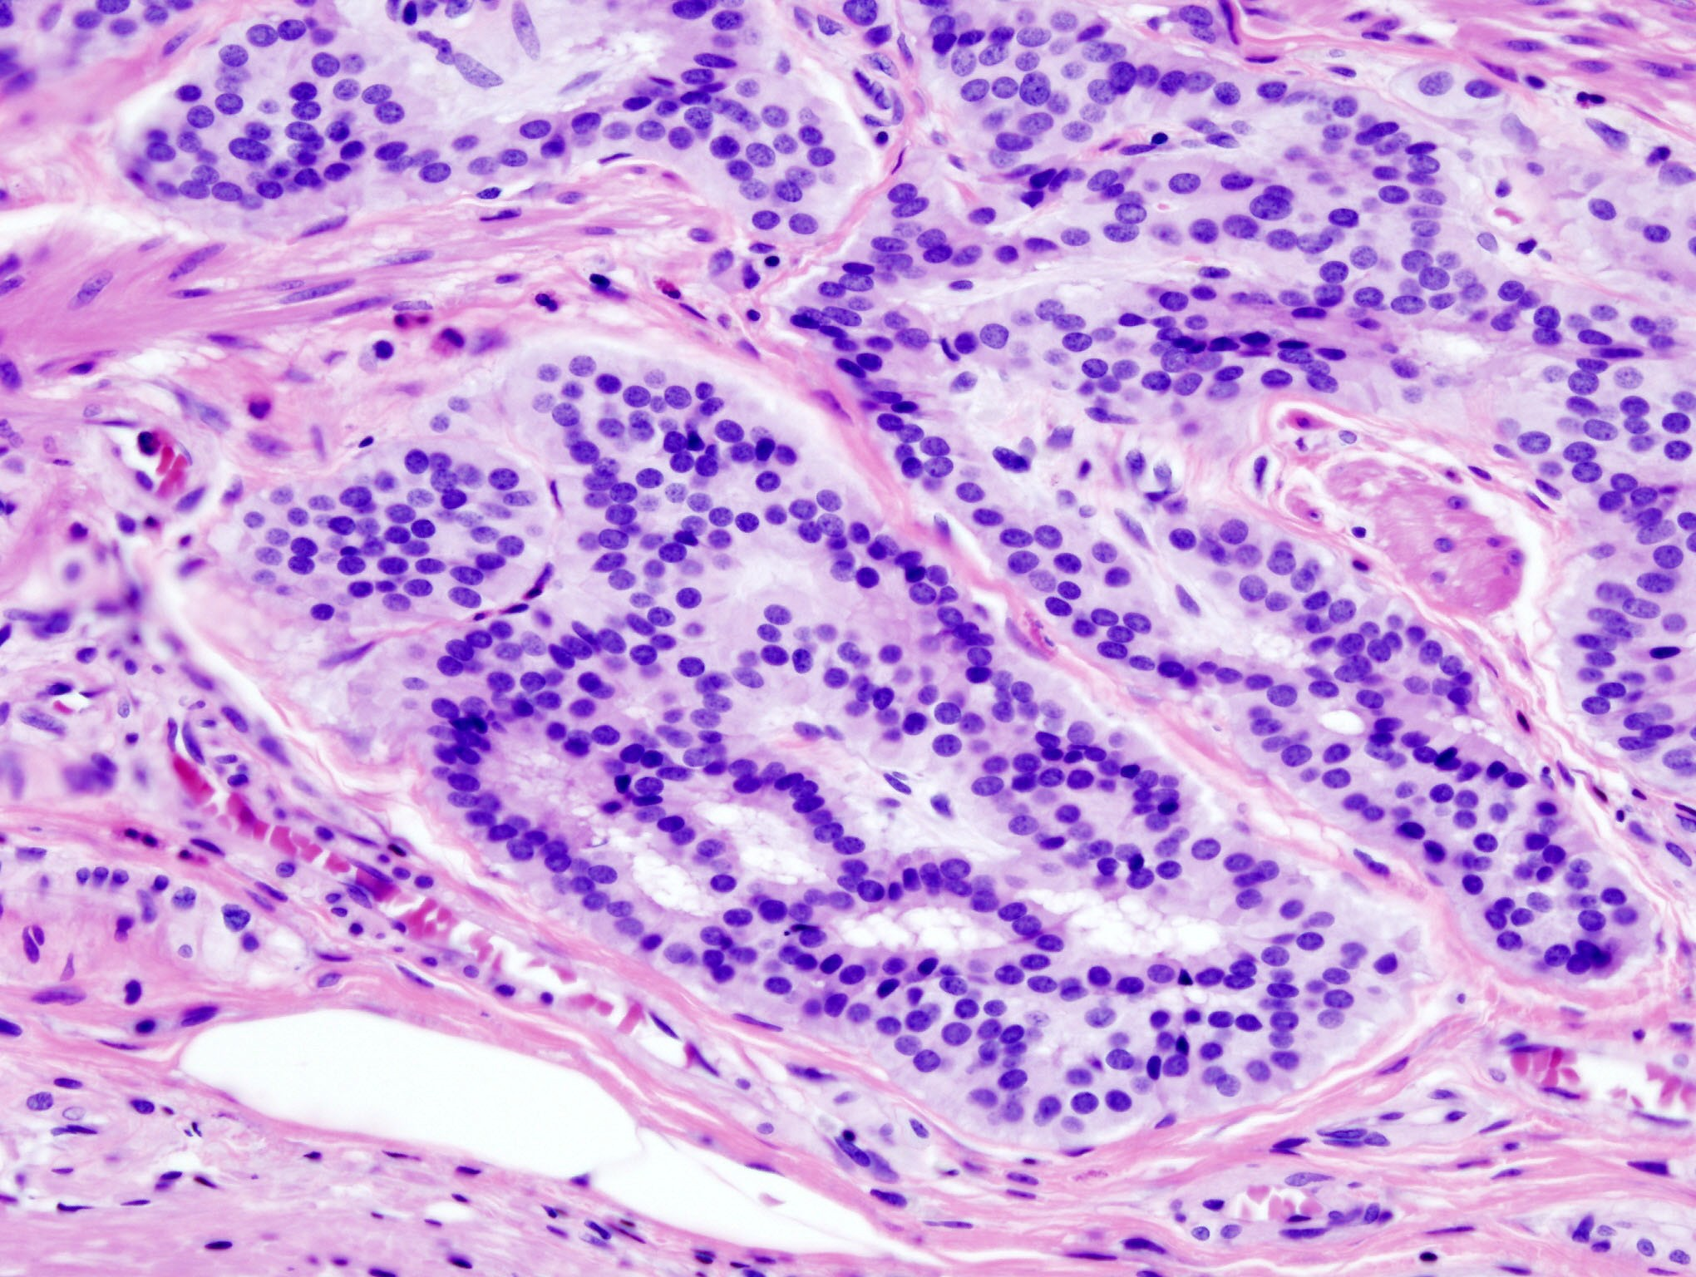
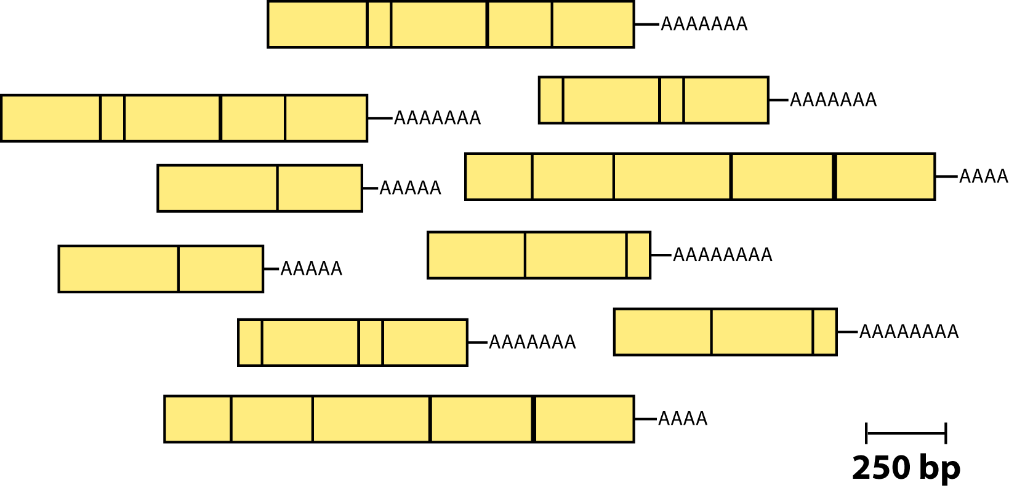
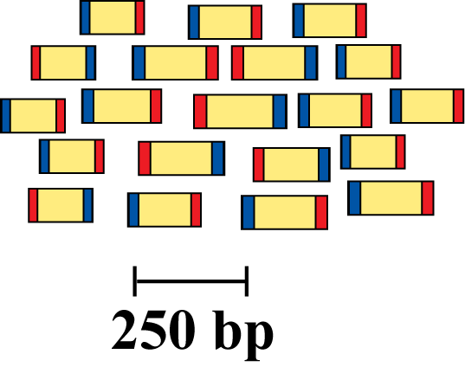
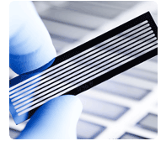
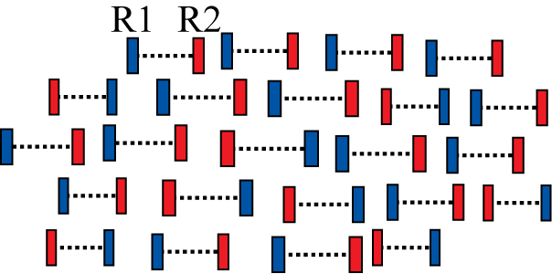
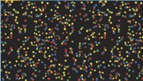
RNA-seq: Abundance comparisons between two or more conditions
Samples of interest
Isolate RNA
Generate cDNA, fragment, size select, add adaptors
Remove rRNA
Normal - control
Diseased - treat
Sequence fragments
Map to genome/transcriptome assembly
Downstream analysis

Slide 12
RNA-seq Challenges
Sampling
Purity. Quantity. Quality
RNA abundances vary by orders of magnitude
Highly expressed genes can over power genes of interest
Ribosomal RNA
RNA is fragile, needs to be properly handled
RNA population turns over quickly in a cell

Slide 13
Alternative Splicing
Single gene can code for multiple variant proteins
Each is termed isoform
Occurs regularly in Eukaryotes
Leishmania is one exception
In humans ~95% of multi-exonic genes are alternatively spliced
Source of variation within and between individuals

Slide 14
Alternative Splicing

Slide 15
Experimental Design
Biological question?
How much sequencing do I need?
Type of sequencing
PE vs SE
How much multiplexing can I do
Pool samples?
How many replicates?

Slide 16
Experimental Design
How much sequencing do I need?
Humans/Mouse – 15 to 30 million reads per sample
Bacteria – 2 to 4 million reads per sample

Slide 17
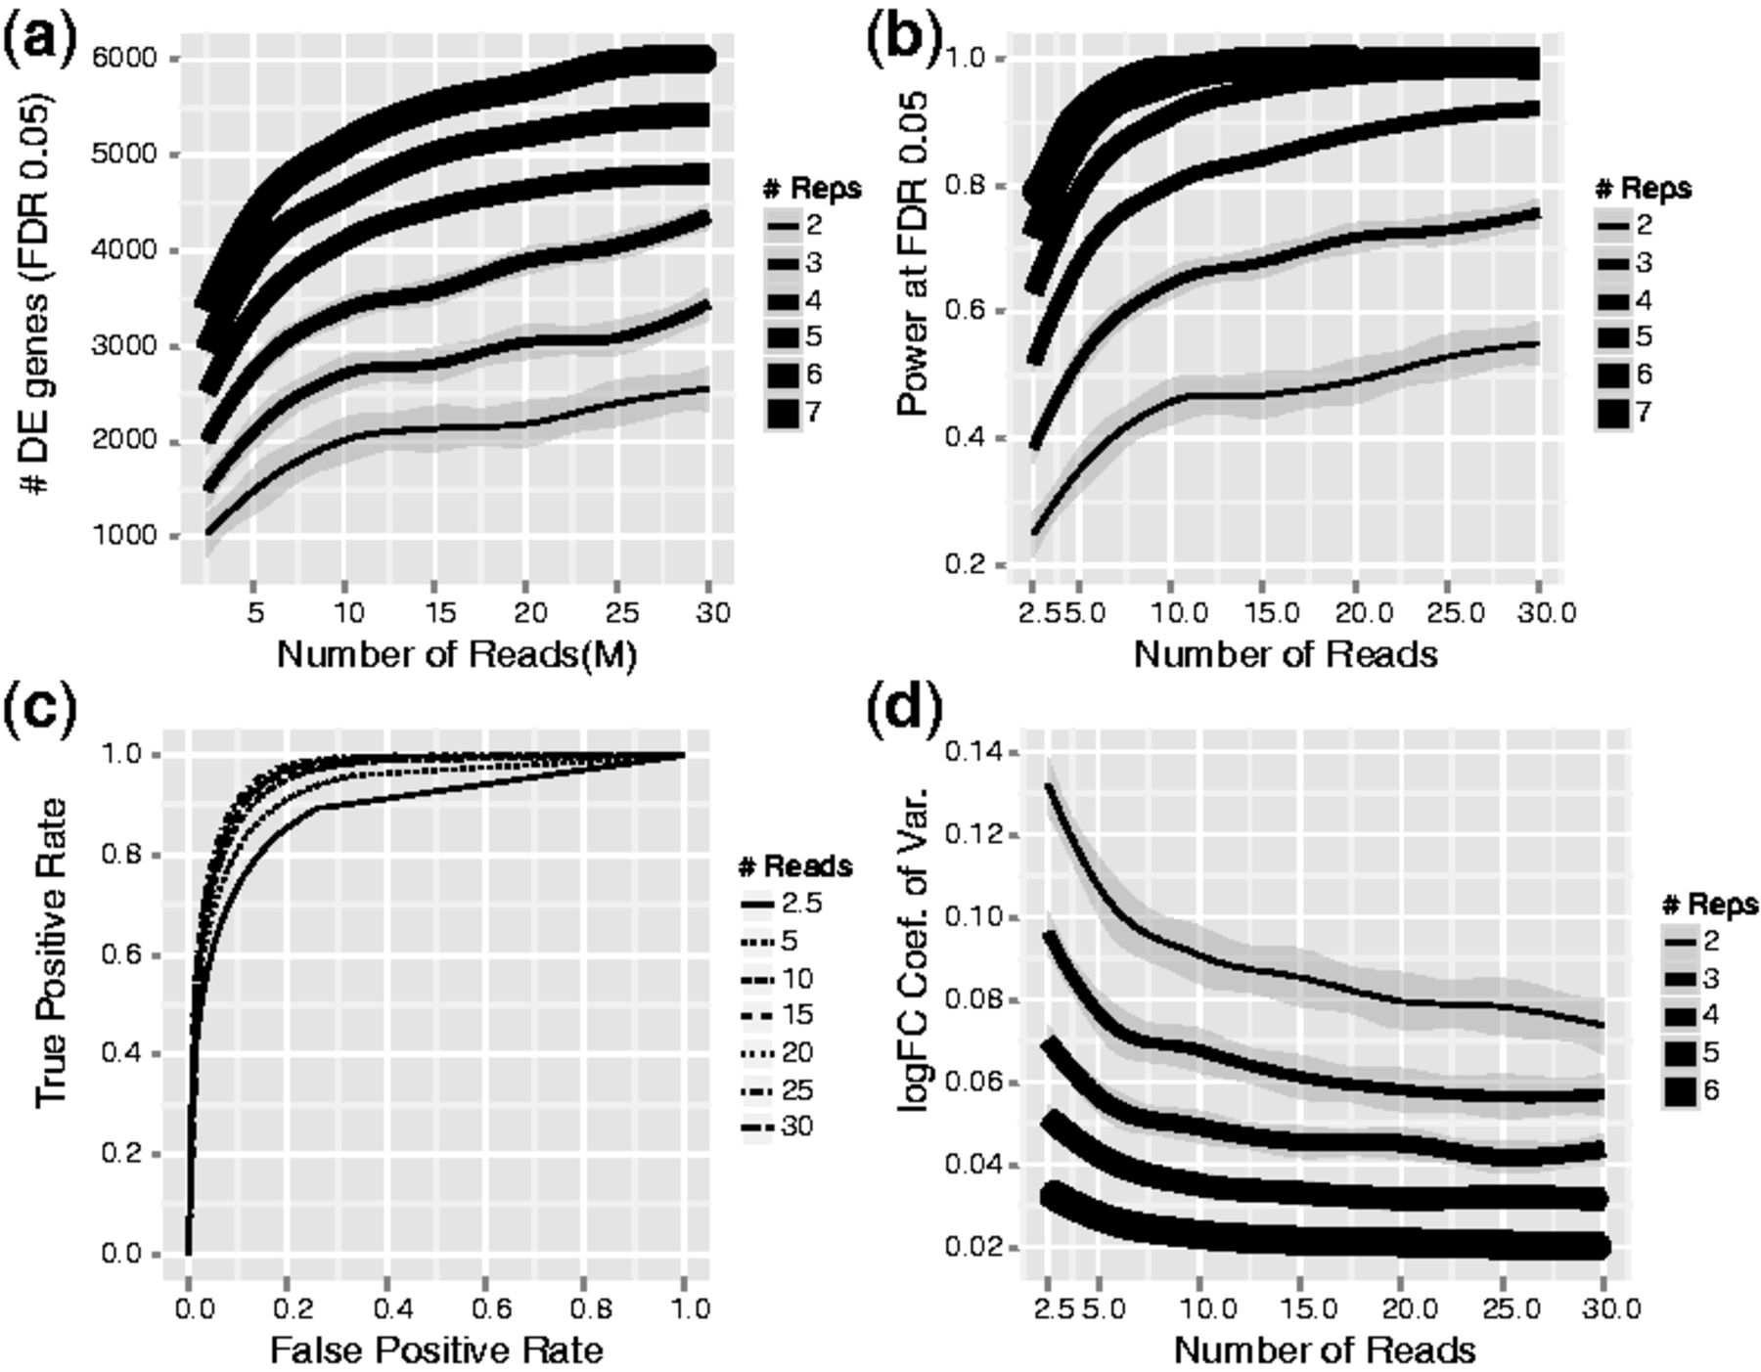
Experimental Design

Slide 18
Experimental Design
Read Type | Platform | Uses
50 SE | Illumina | Gene Expression Quantification SNP-finding (Good Reference)
50 PE | Illumina | Above plus Splice variants
100+ PE | Illumina | Above plus Transcriptome assembly
 |  | DE within gene families
200+ | Ion Torrent Sanger | Splice variants Transcriptome assembly
 | 454 Nanopore | Haplotypes Too large for DE

Slide 19
Experimental Design

Slide 20
Multiplexing
6-8 nucleotide barcodes added to samples during library prep
Pool samples into same sequencing lane
Mitigates lane effects
Maximizes sequencing efficiency

Slide 21
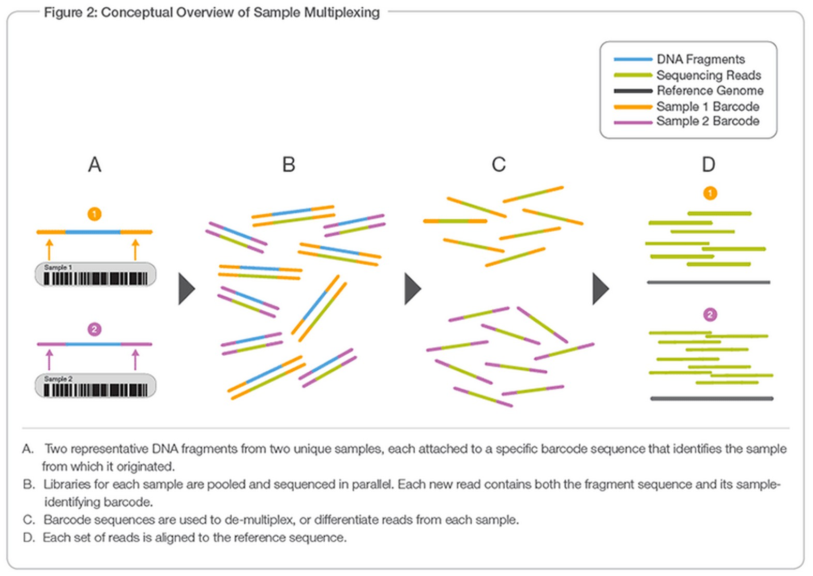
Multiplexing

Slide 22
Replicates
Biological replicates necessary for statistical analaysis
More = better

Slide 23
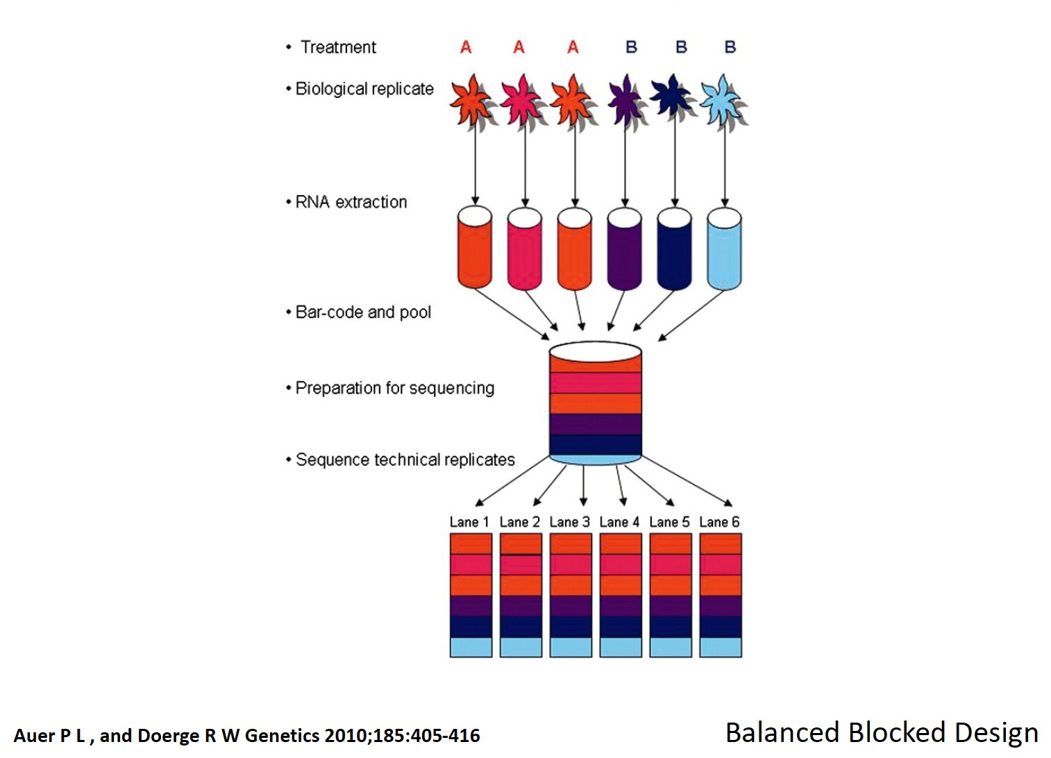
Replicates

Slide 24
Quality Control
Fastq format
@M03264:1:000000000-AB9MU:1:1101:9844:1771 1:N:0:5
TATTCTGTGACTAGATTTTTTGAGAATAAATCAGAATACAATTCATTCTTTGATATACAAGTATCGCCCAT
+
CGGGGGGGGGGGGGGGGGGGGGGGGGGGGGGGGFC<FCFFDGGGGGGGGGGGCGFGGGFFFGGGGGGGGGG

Slide 25
Quality Control
Fastq format
@M03264:1:000000000-AB9MU:1:1101:9844:1771 1:N:0:5
TATTCTGTGACTAGATTTTTTGAGAATAAATCAGAATACAATTCATTCTTTGATATACAAGTATCGCCCAT
+
CGGGGGGGGGGGGGGGGGGGGGGGGGGGGGGGGFC<FCFFDGGGGGGGGGGGCGFGGGFFFGGGGGGGGGG
Quality Score | Probability of Incorrect Base Call | Inferred Base Call Accuracy
10 (Q10) | 1 in 10 | 90%
20 (Q20) | 1 in 100 | 99%
30 (Q30) | 1 in 1000 | 99.9%

Slide 26
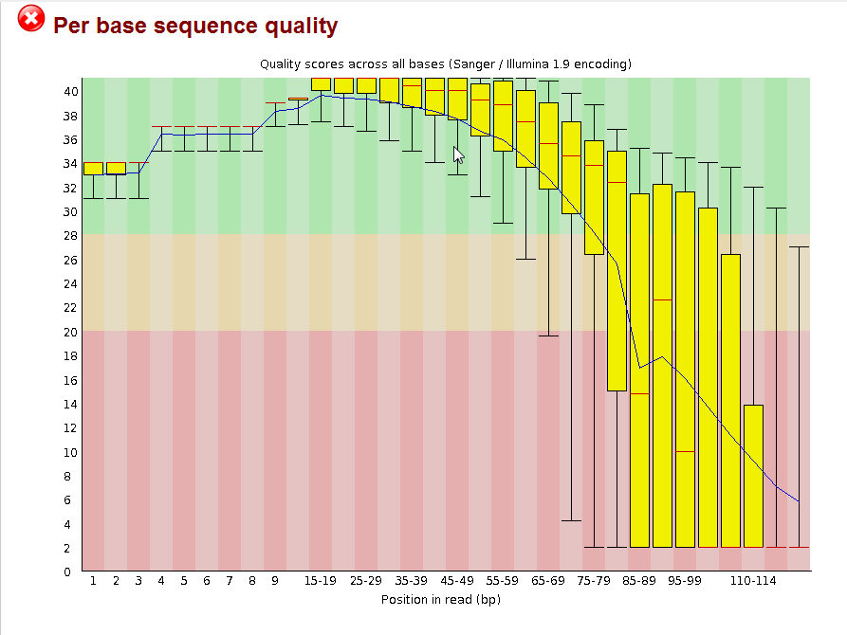
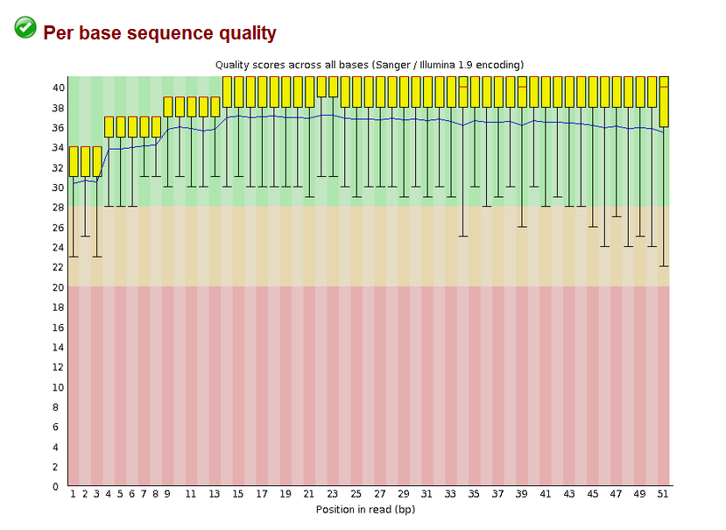
Quality Control

Slide 27
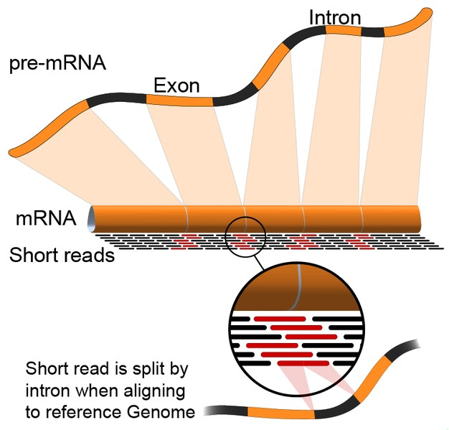
Mapping RNAseq Reads
Splice aware?
TopHat, HISAT2,
STAR, Kallisto
bowtie2

Slide 28
Alignment Files SAM/BAM
https://samtools.github.io/hts-specs/SAMv1.pdf
M03509:58:000000000-B5VDH:1:1107:21218:7668 99 NC_001318.1 155 42 75M = 162 80 ATTTTGTTTTCAAAATAAATTAACTACTTCTCGATGGGAATTCCCTAAAGAAGATTTAATTAAAAAAAAAATAAA
<CCCCGGGF?FFDAF9FGGC@CFGGFF9FAF@@FECF@FGG<E9EFFGGDFGGGGFFGEGGFADFDFCFC:EFGG AS:i:0 XN:i:0 XM:i:0 XO:i:0 XG:i:0 NM:i:0 MD:Z:75 YS:i:-11 YT:Z:CP

Slide 29
Viewing Mapped Reads - IGV

Slide 30
General Workflows
Obtain raw sequenced data
QC trimming
Align/assemble reads
Process alignment with appropriate tool for goal
Post process
Importing counts tables into downstream software
R, matlab, cytoscape
Summarize and visualize
Create gene lists, prioritize candidates for validation

Slide 31
General Workflows
Prokaryote
Condition A
Condition B
QC trimmed reads
QC trimmed reads
bowtie2
MappedA.bam
MappedB.bam
HTSeq
Counts_A
Counts_B
Counts_matrix
DESeq2
Differentials

Slide 32
General Workflows
Eukaryote
Condition A
Condition B
QC trimmed reads
QC trimmed reads
HISAT2
MappedA.bam
MappedB.bam
Stringtie
Assembled transcripts A
Assembled transcripts B
Stringtie
Final transcript assembly
MappedA.bam
MappedB.bam
Counts matrix
Ballgown
Differentials

Slide 33
Hands On
https://www.bioconductor.org/packages/devel/workflows/vignettes/rnaseqGene/inst/doc/rnaseqGene.html

Slide 34
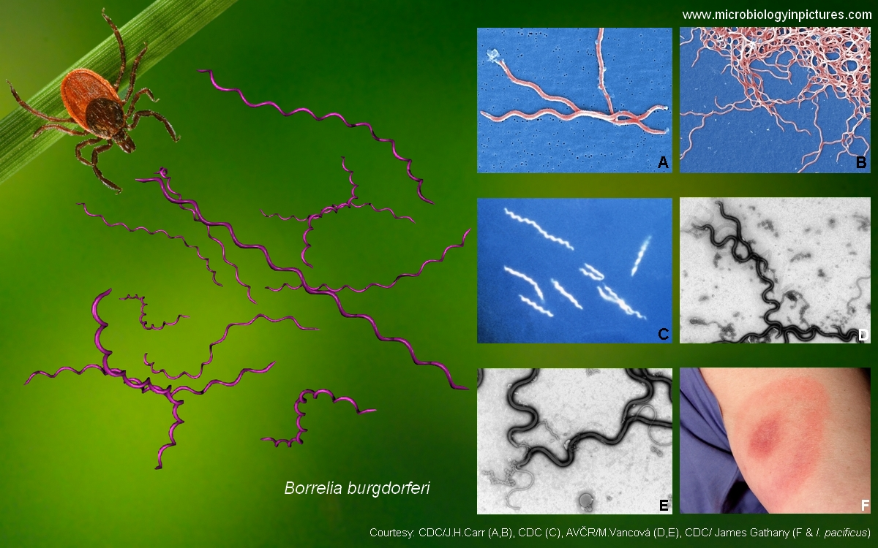
Borrelia burgdorferi
Causative agent of lyme disease
Tick borne

Slide 35
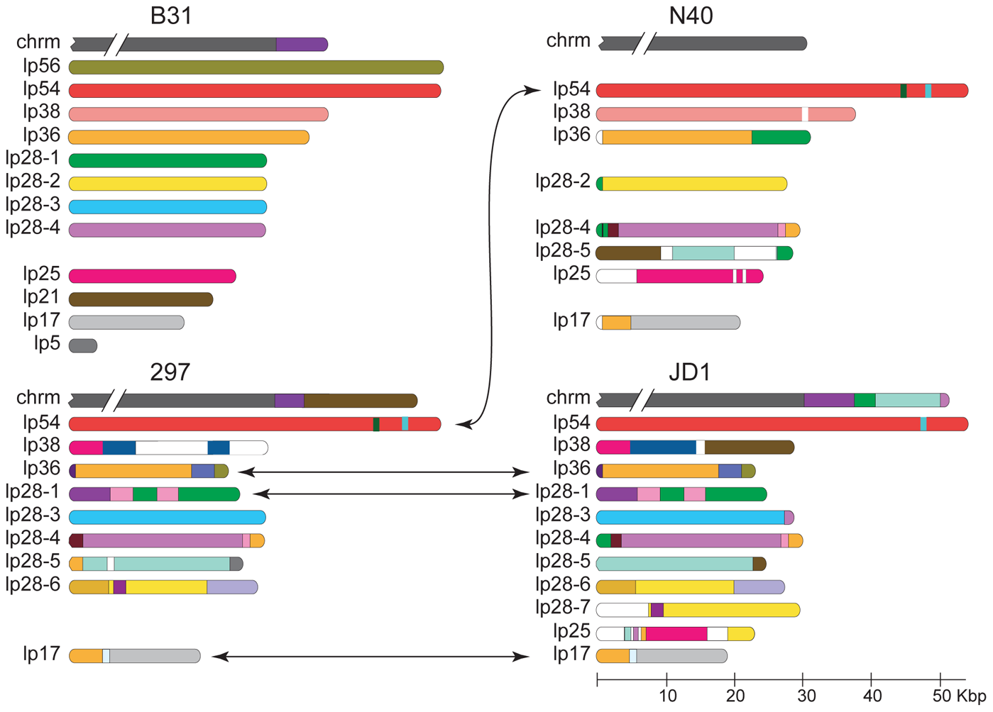
Borrelia burgdorferi
Linear chromosome
19 linear and circular chromosomes
~950 genes

Slide 36
Borrelia burgdorferi
3 treatments
pH 7.6 control
pH 6.8 control
pH 6.8 + NO

